Slide 1



Scaling production grade Kubernetes Multi-Cluster environments using GitOps
Carlos Santana
Rodrigo Bersa
EKS Specialist Solutions Architect AWS
EKS Specialist Solutions Architect AWS

Slide 2
I have chosen to use Kubernetes – now what?

Slide 3
What customers are building
Legacy app modernisation
Data processing
Web applications
AI/ML
Backends
.NET apps
Legacy homegrown Linux apps
Monoliths
Autonomous vehicles (object tracking, sensor fusion)
Robotics (vision, grasping, motion control)
Modeling, training, and inference
Real-time
MapReduce
Batch
Apps and services
Mobile
IoT
Static websites
Complex web apps

Slide 4


Challenges and Goals
Cluster management
Enforce security standards and best practices across clusters to automate deployments
Team management
Define boundaries between multiple teams
Add-on management
Install add-ons and their dependencies
Workload management
Provision multiple workloads at scale
Configuration management
Automate configuration and upgrade lifecycle from a single source of truth

Slide 5
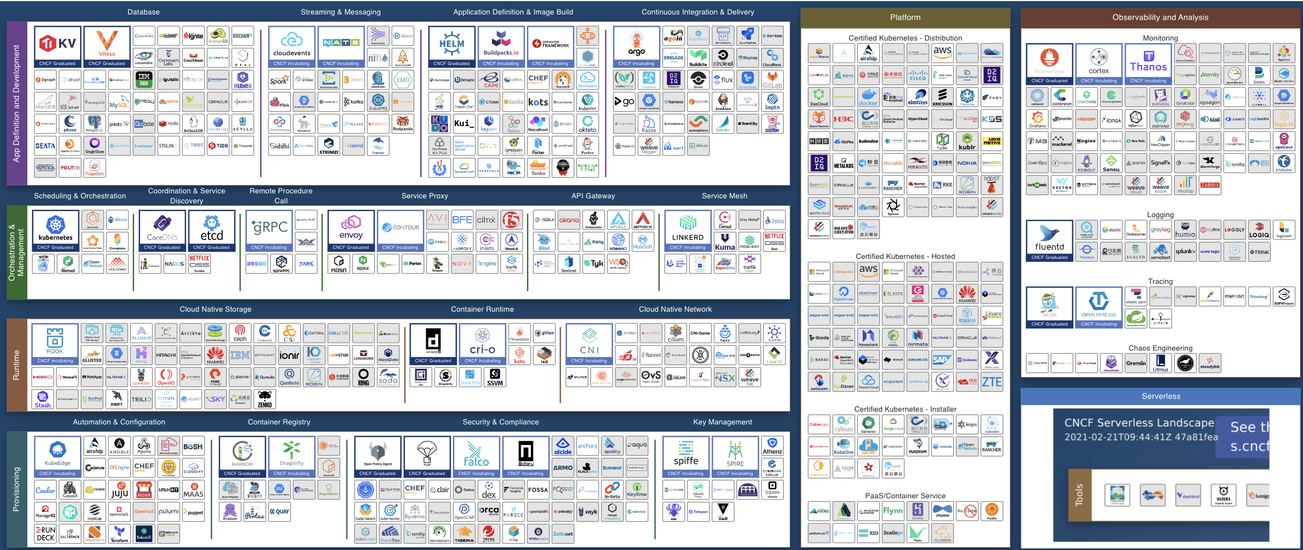
CNCF Cloud Map
“There is no shortage of amazing tooling in the K8s ecosystem, but there is no guide for how to put all the tools together”

Slide 6
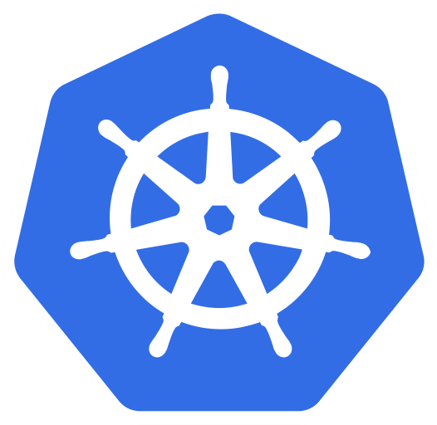
Kubernetes Journey
Choose an orchestrator
Decisions

Slide 7




Kubernetes Journey
Choose an orchestrator
Data Plane Compute
Decisions

Slide 8


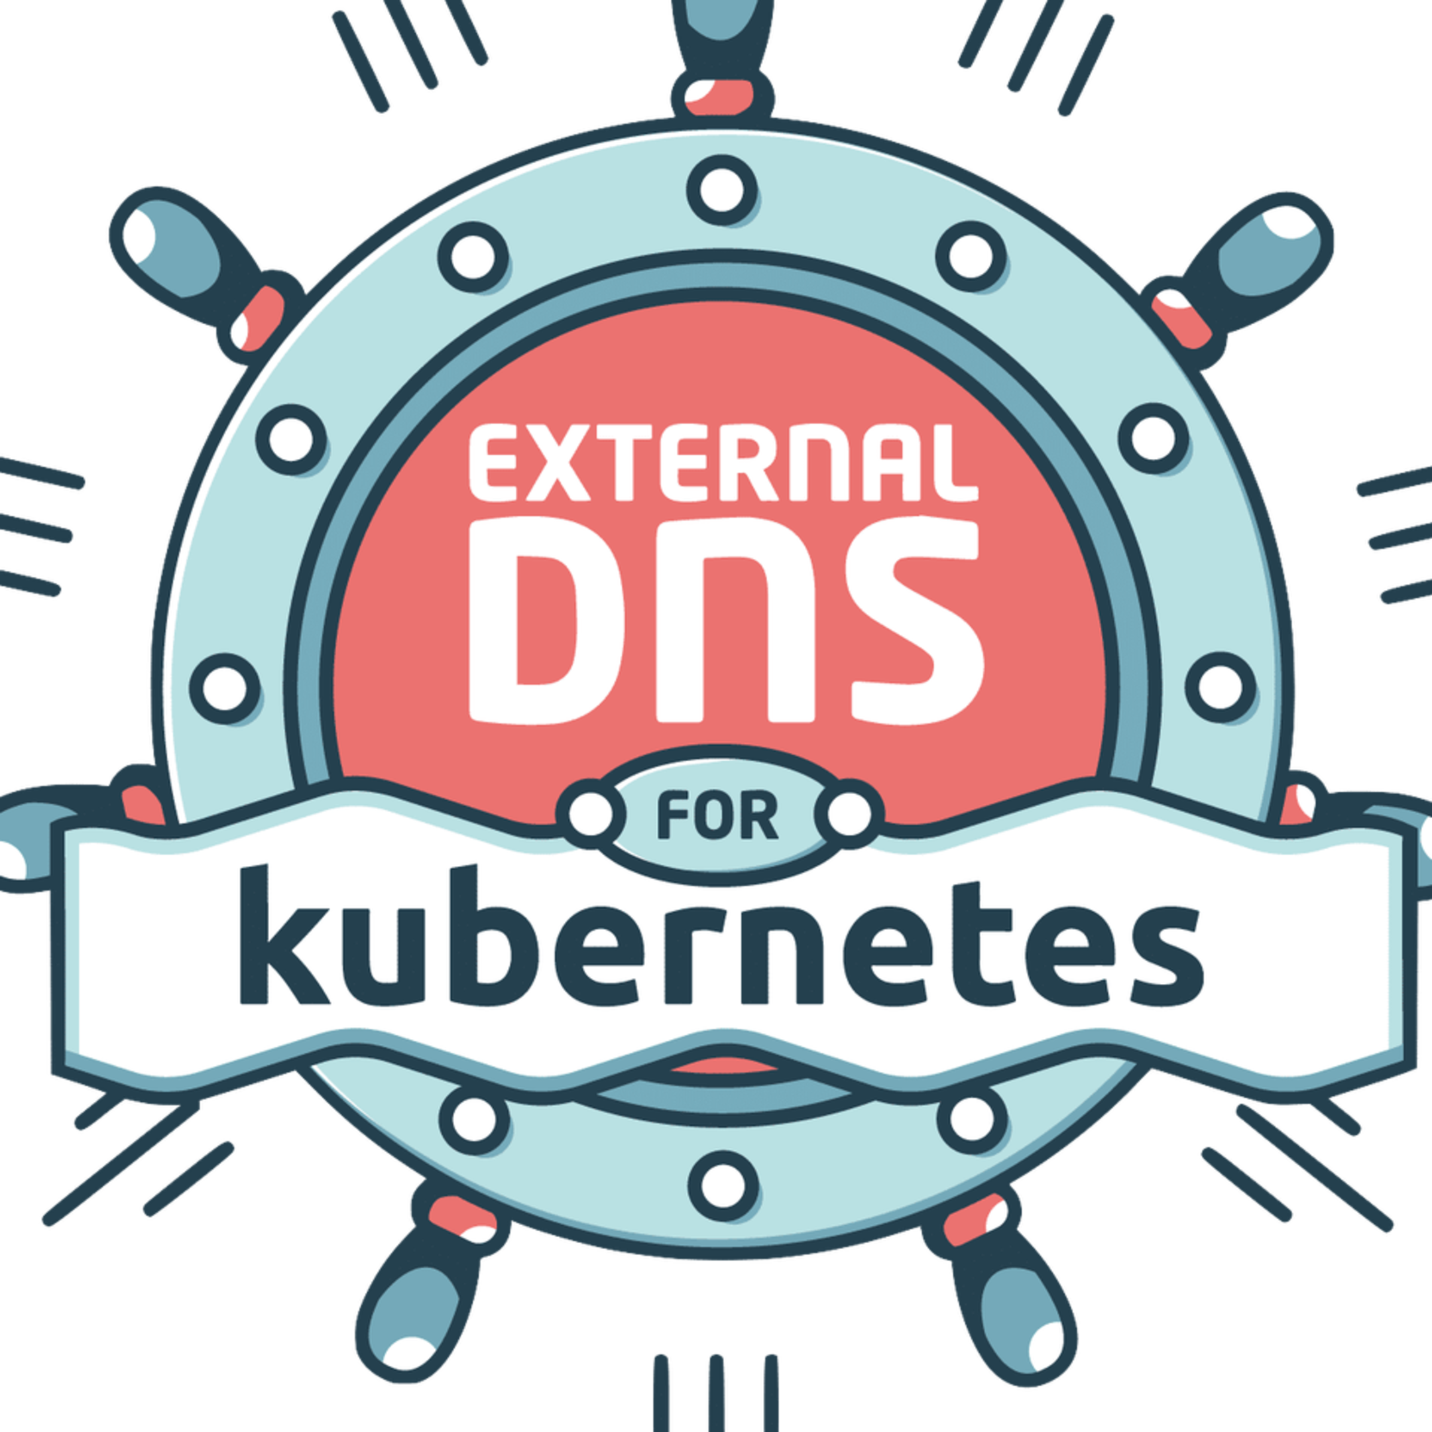

Kubernetes Journey
Choose an orchestrator
Data Plane Compute
Cluster Addons
Decisions

Slide 9
Kubernetes Journey
Choose an orchestrator
Data Plane Compute
Day 2 Operations
Cluster Addons
Decisions

Slide 10



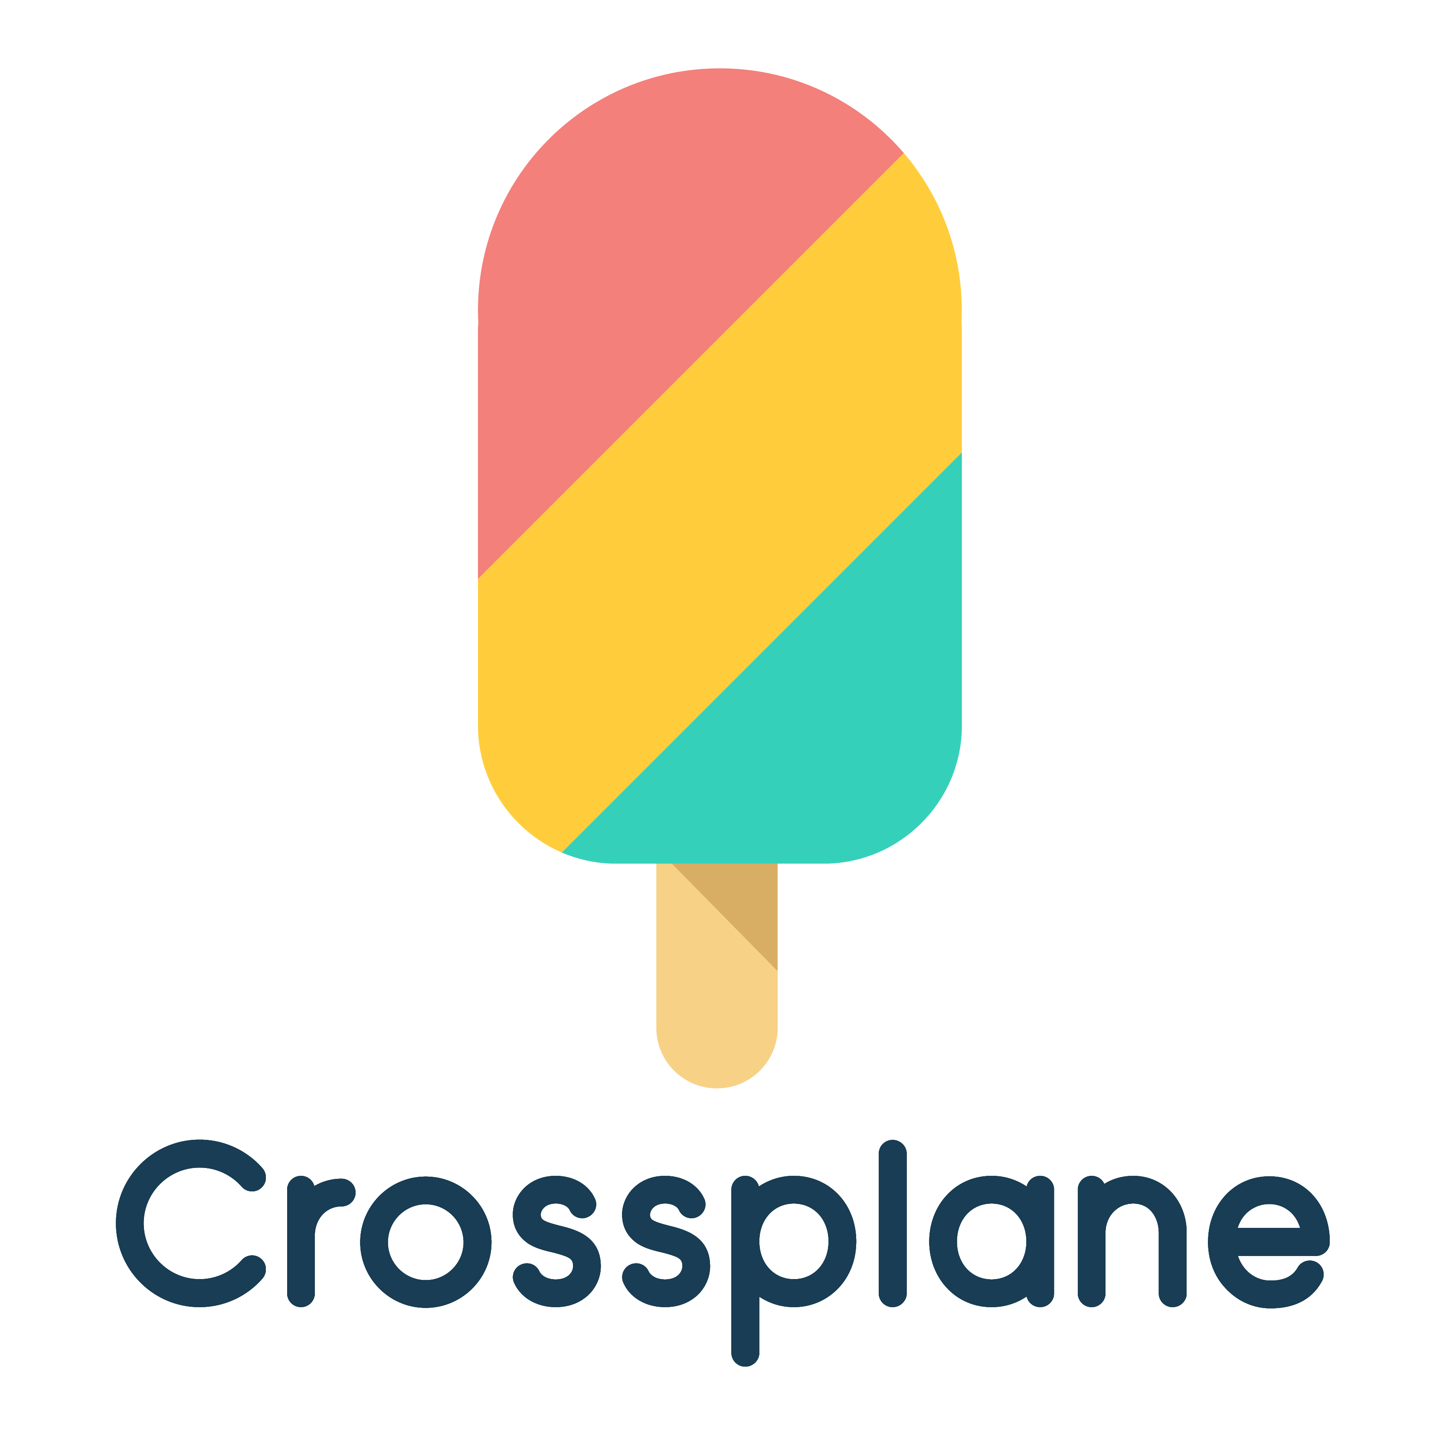
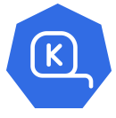

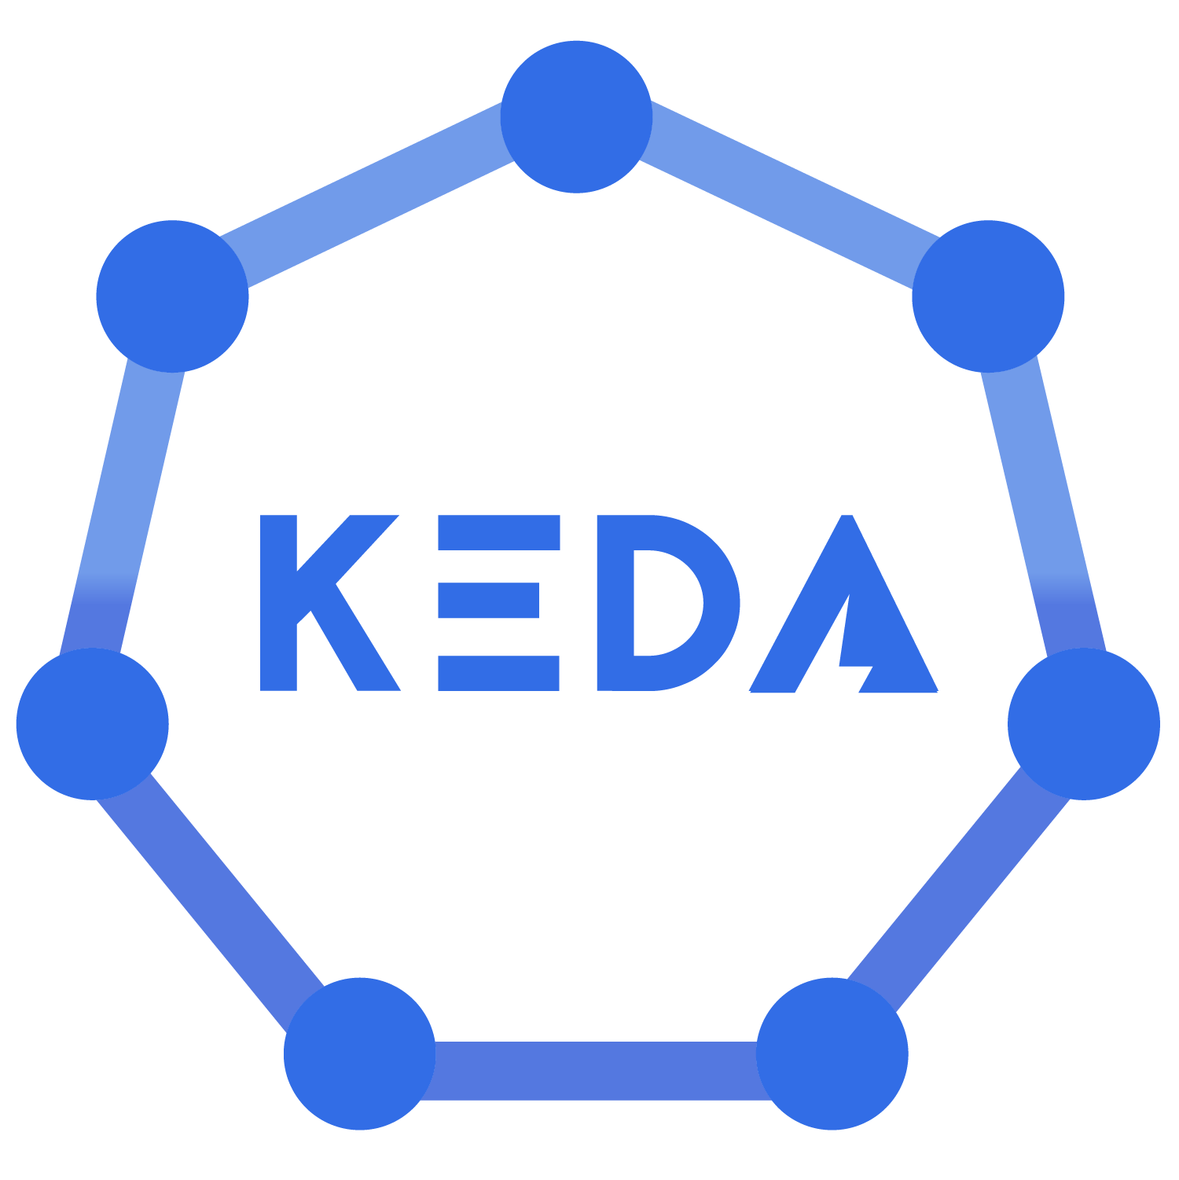
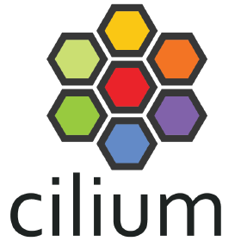
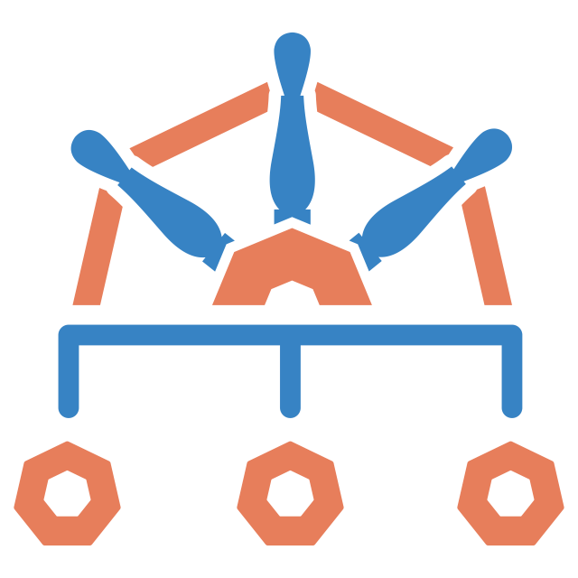



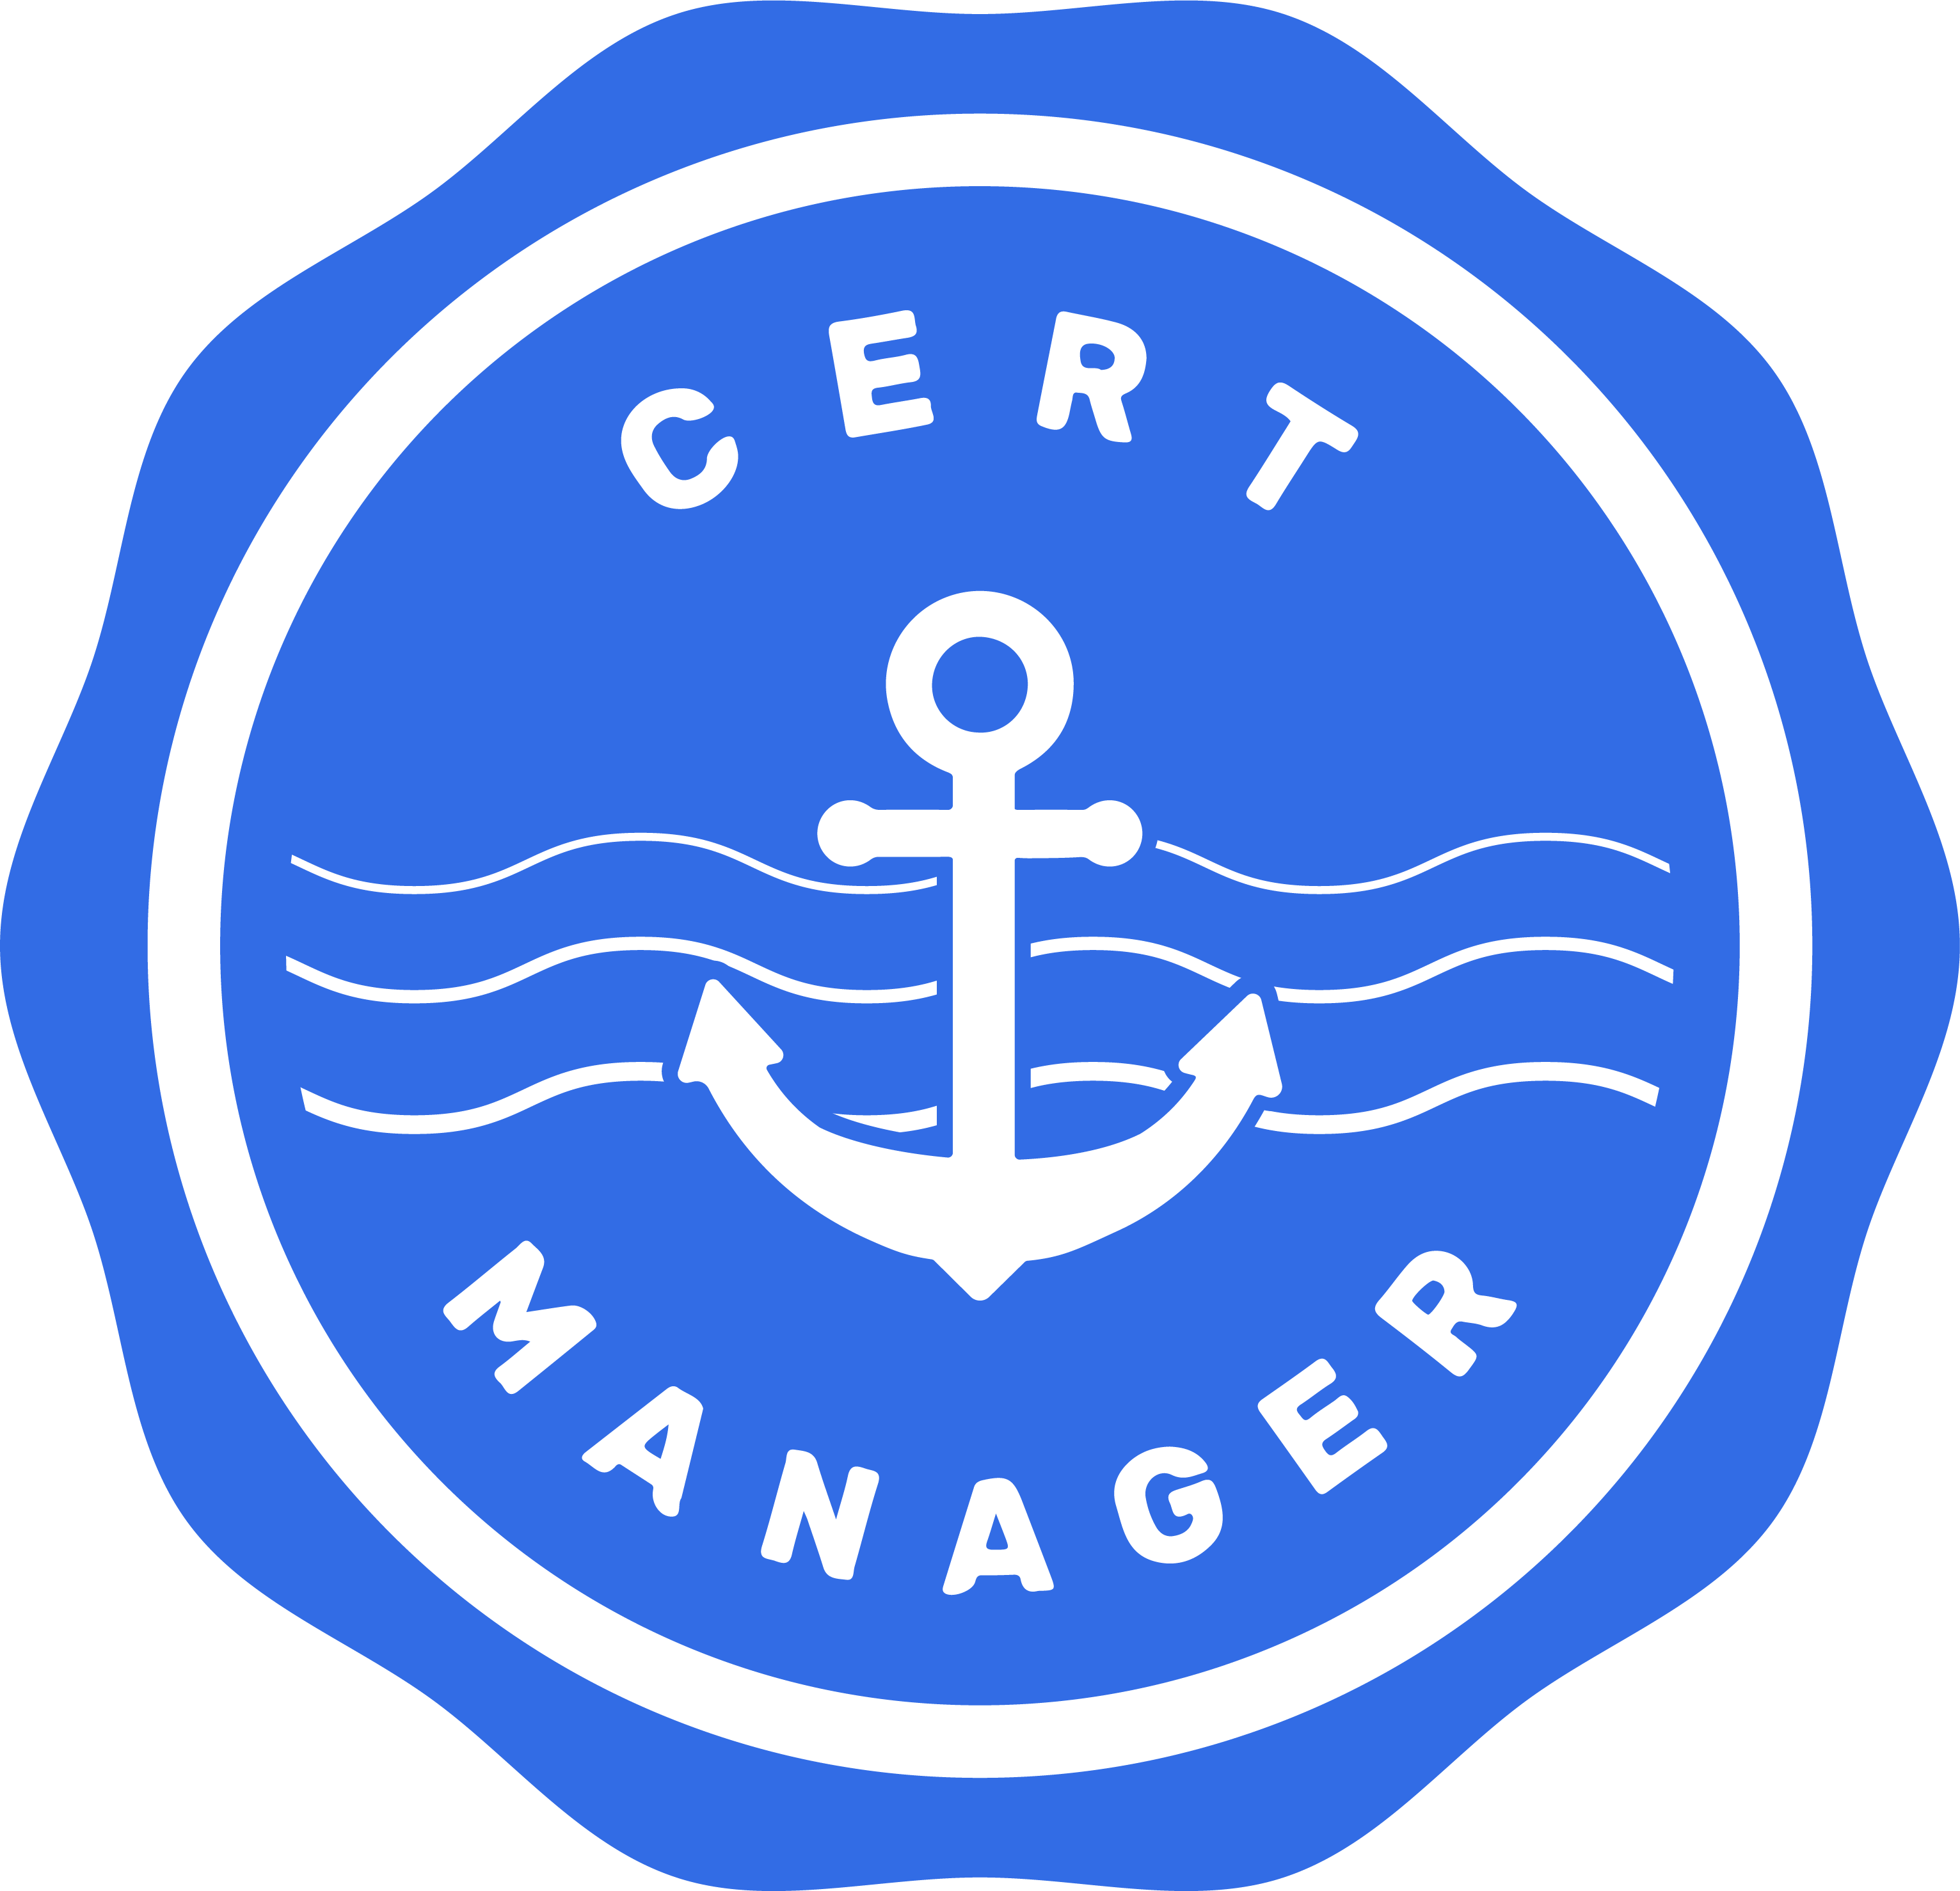



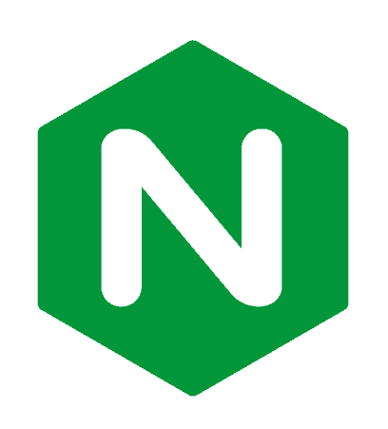


Cluster add-ons
Observability
Delivery
Prometheus
Fluent Bit
OTEL
ArgoCD
Flux
Crossplane
Reliability
Security
Karpenter
Autoscaler
Keda
Cilium
Kyverno
Gatekeeper
Other

Slide 11

Principle of GitOps
A system managed by GitOps must have its desired state expressed declaratively
Desired state is stored in a way that enforces immutability, versioning and retains a complete version history
Software agents automatically pull the desired state declarations from the source
Software agents continuously observe actual system state and attempt to apply the desired state
Reduces Business Risk
Enhances Auditability
Boosts Security
Enforces Consistency

Slide 12
GitOps Continuously Reconcile
Scan
Deploy/Verify
Git becomes the single source of truth for the system’s desired state, enabling reproducible automated deployments, cluster management, and monitoring.
Test
Observe/Alert
Build
Operate/Fix
Immutability Firewall

Slide 13
Secure environments

Slide 14
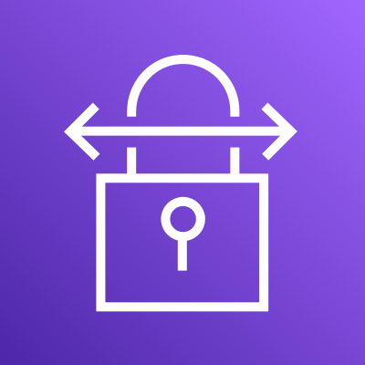




Private environments
Corporate Network
Corporate datacenter
Kubernetes Cluster
Infrastructure deployment
Build

Slide 15



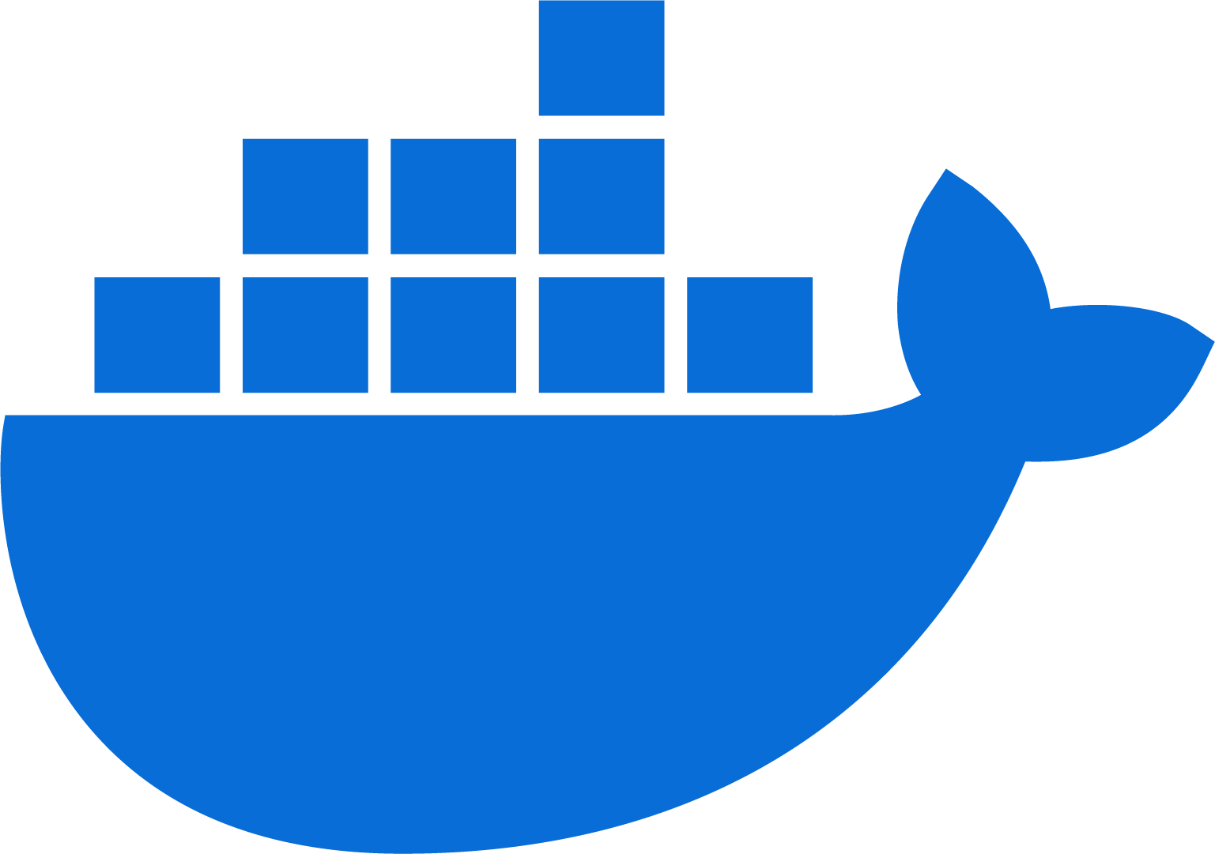
Public repositories
Corporate Network
Deploy
Corporate datacenter
Kubernetes Cluster
Infrastructure deployment
Build

Slide 16
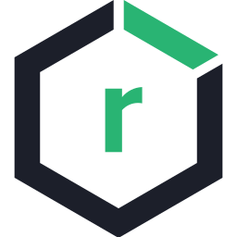



Private repositories
Corporate Network
Corporate datacenter
Repository
Scan
Pull
Clair
Grype
Kubernetes Cluster
Scan
Store
Deploy
Build
Infrastructure deployment

Slide 17

Trusted repositories
Corporate Network
Corporate datacenter
Repository
Image replication
Scan
Pull
Clair
Grype
Kubernetes Cluster
Scan
Store
Deploy
Build
Infrastructure deployment

Slide 18


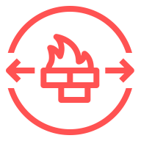

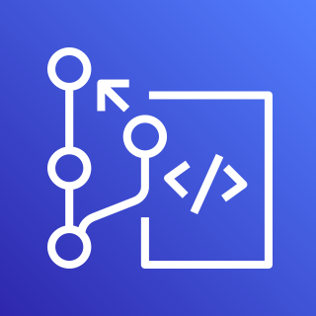


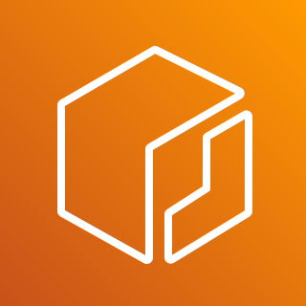


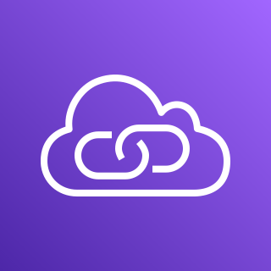

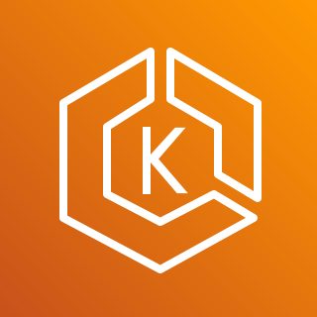
Cloud environment
AWS Cloud
VPC
Secured Network
AWS CodeCommit
Private subnet
Endpoints
Image replication
Store
Scan
Amazon ECR
Amazon Inspector
VPN connection
AWS PrivateLink
Build
Deploy
AWS Direct Connect
Amazon EKS
Infrastructure deployment

Slide 19
Team management

Slide 20



Multi-team considerations
Identity & Access
Management
Policy
Management
Namespace as a
Service

Slide 21
Separation of concerns
Platform engineers
Platform builders – build and integrate tools that provision, manage and secure the cloud computing infrastructure
Software engineers
Application builders – free to focus on building applications that deliver business value to customers

Slide 22

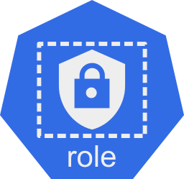
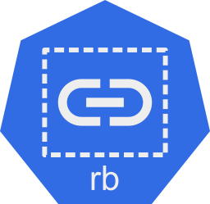

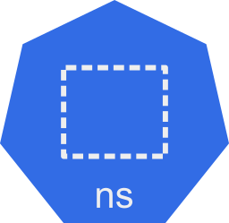

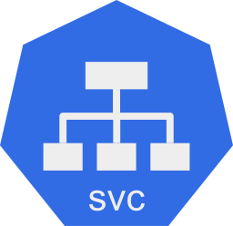

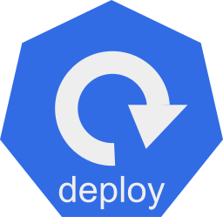
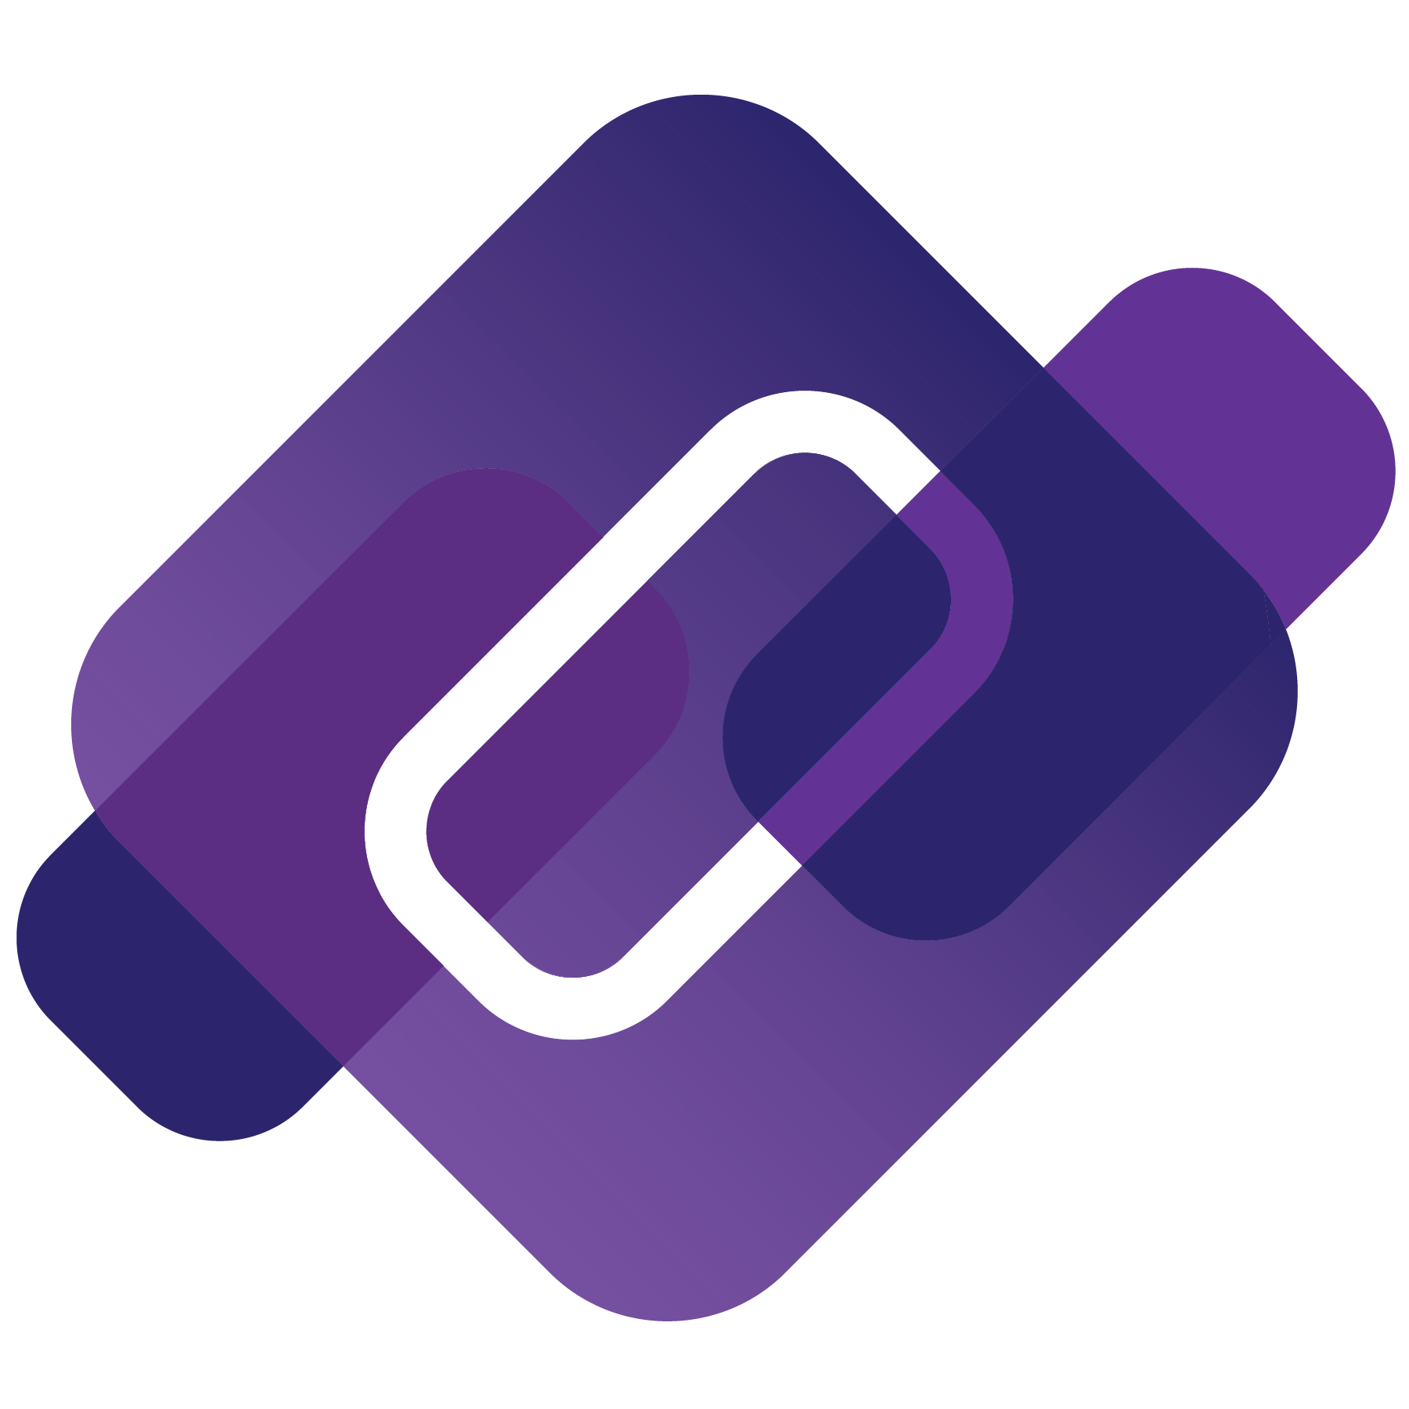
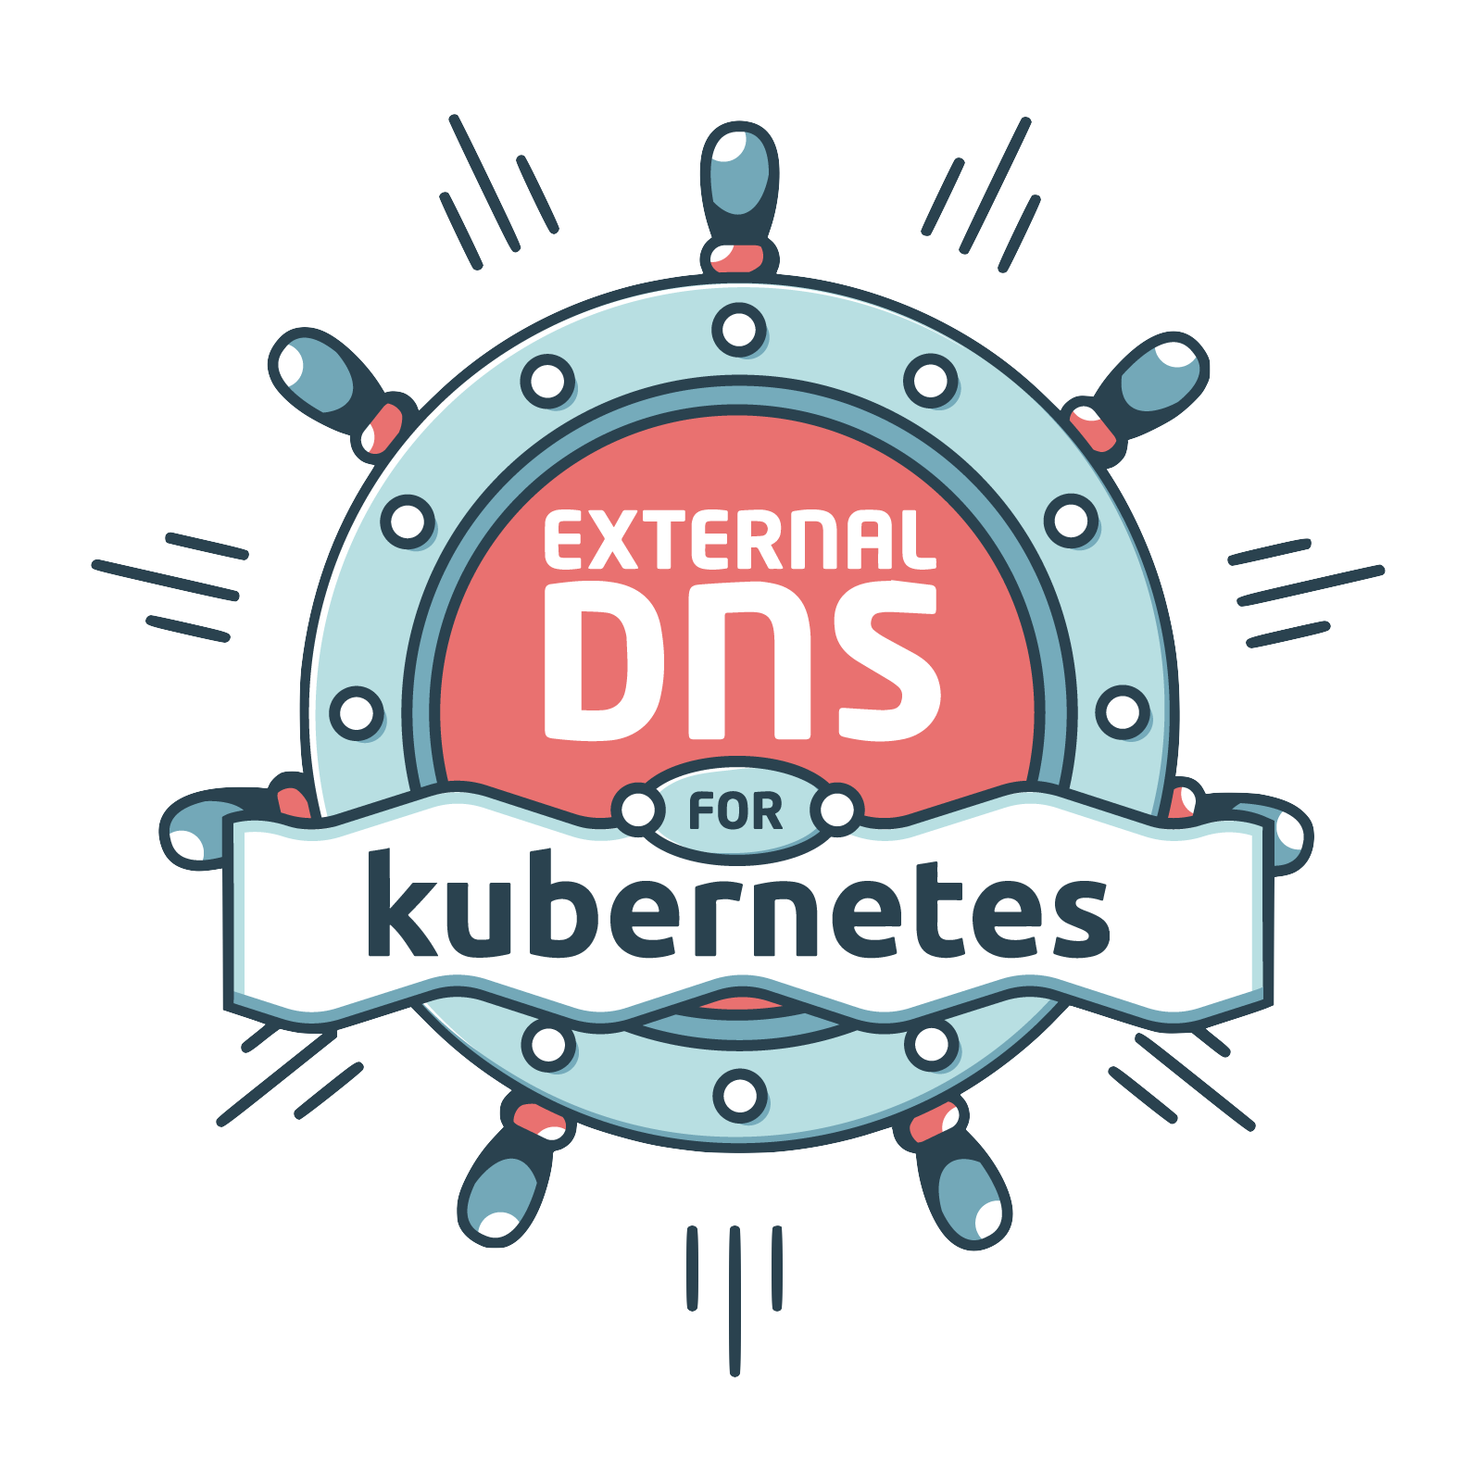
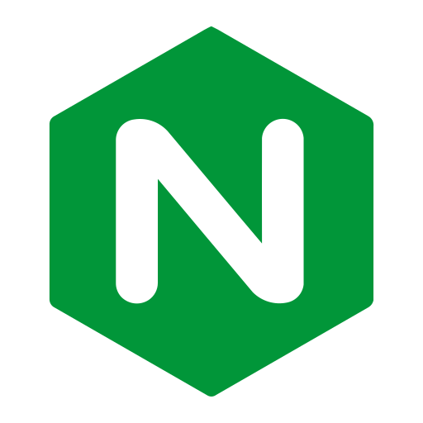

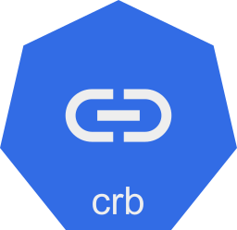
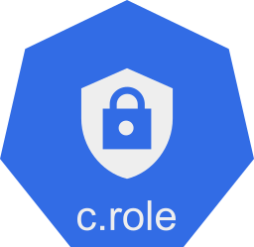
Teams management (k8s)
Kubernetes Cluster
Dev Team A
Control Plane
Dev Team B
Developer RBAC
Data Plane
Audit Team
Temp RBAC
Instances
Instances
Platform Team
Admin RBAC

Slide 23

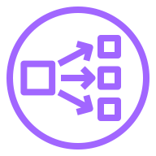

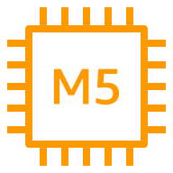

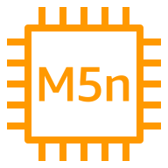
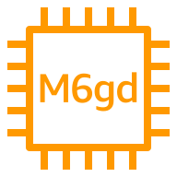
Teams management (cloud)
AWS Cloud
Availability Zone 1
Availability Zone 2
Dev Team A
VPC
Amazon EKS
Developer Role
Managed Node Group
Dev Team B
Audit Team
Temporary Role
Karpenter “Groupless”
Platform Team
Admin Role

Slide 24

Teams management (ArgoCD)
Dev Team A
Dev/Test Cluster
Apps
ArgoCD Projects
Apps Repository
Production Cluster
Dev Team B
workloads
policies
Audit
ArgoCD Project
Policy Repository
Audit Team
addons
Platform
ArgoCD Project
Platform Repository
Platform Team

Slide 25
Multi-Cluster Management with GitOps (Topologies)

Slide 26



Standalone/distributed GitOps
Full ArgoCD
UI/CLI
API Server
Redis Server
Repo
Controllers
Tenant AWS account
On premises
Amazon EKS
Kubernetes
Namespace
Namespace
Tenant AWS account
On premises
Amazon EKS
Kubernetes
Namespace
Namespace
Notes:
Other topology is sometimes called a standalone or distributed GitOps. In this scenario, each cluster has its own GitOps instances, which points to the central git repository.
Some benefits
GitOps Controller self contain to the Cluster, no need to register with a centralized environment
Isolation and Authentication – no single point of access to all other environments
Scaling requirements is lower for GitOps Instance
A few drawbacks from this topology are
User Access – can be challenging at scale
Upgrades/updates – has to have a proper add-ons upgrade process that includes the GitOps tooling

Slide 27
Centralized/Hub-Spoke (Push)
Full ArgoCD
UI/CLI
API Server
Redis Server
Repo
Controllers
Tenant AWS account
Central AWS account
On premises
Amazon EKS
Kubernetes
Central Amazon EKS cluster
Namespace
Tenant AWS account
On premises
Amazon EKS
Kubernetes
Notes:
With the centralized topology, we have a single GitOps instance that manages all target environments
Some benefits
Management of single GitOps instances
Centralized access for users
Consistent configuration of addons across all remote clusters
A few drawbacks from this topology are
Challenges to configure at scales of 10s/100s of clusters
Cluster creation is not isolated – meaning that each new environment needs to register with the centralized GitOps instance
Networking – The GitOps instance accessing private clusters, requiring custom networking

Slide 28
Centralized/Hub-Spoke (Shared)
Full ArgoCD
UI/CLI
API Server
Redis Server
Repo
Controllers
Tenant AWS account
Central AWS account
On premises
Amazon EKS
Kubernetes
Central Amazon EKS cluster
App-1 repo
Namespace
App-3 repo
Tenant AWS account
On premises
Amazon EKS
Kubernetes
App-2 repo
App-4 repo
Platform Config
Notes:
Another option is to have a hybrid approach where a centralized GitOps instance is used to manage all remote cluster configuration.
Within each cluster, there will be another GitOps tooling installed, that will manage the application deployment for those cluster.
This method is helpful when platform teams are building a Cluster-as-a-Service, by setting and managing consistent infrastructure,
while the consumers/application teams are responsible for deploying the application themselves into the cluster

Slide 29

Centralized/Hub-Spoke (Agent)
Full ArgoCD
UI/CLI
API Server
Redis Server
Repo
Controllers
Core ArgoCD
UI/CLI
API Server
Redis Server
Repo
Controllers
Tenant AWS account
Central AWS account
On premises
Amazon EKS
Kubernetes
Central Amazon EKS cluster
App-1 repo
Namespace
App-3 repo
Tenant AWS account
On premises
Amazon EKS
Kubernetes
App-2 repo
App-4 repo
https://argo-cd.readthedocs.io/en/stable/operator-manual/core
https://akuity.io/blog/reducing-argocd-operational-burden
https://github.com/open-cluster-management-io/argocd-pull-integration
Platform Config
Notes:
Another option is to have a hybrid approach where a centralized GitOps instance is used to manage all remote cluster configuration.
Within each cluster, there will be another GitOps tooling installed, that will manage the application deployment for those cluster.
This method is helpful when platform teams are building a Cluster-as-a-Service, by setting and managing consistent infrastructure,
while the consumers/application teams are responsible for deploying the application themselves into the cluster

Slide 30
Reliability and Performance

Slide 31
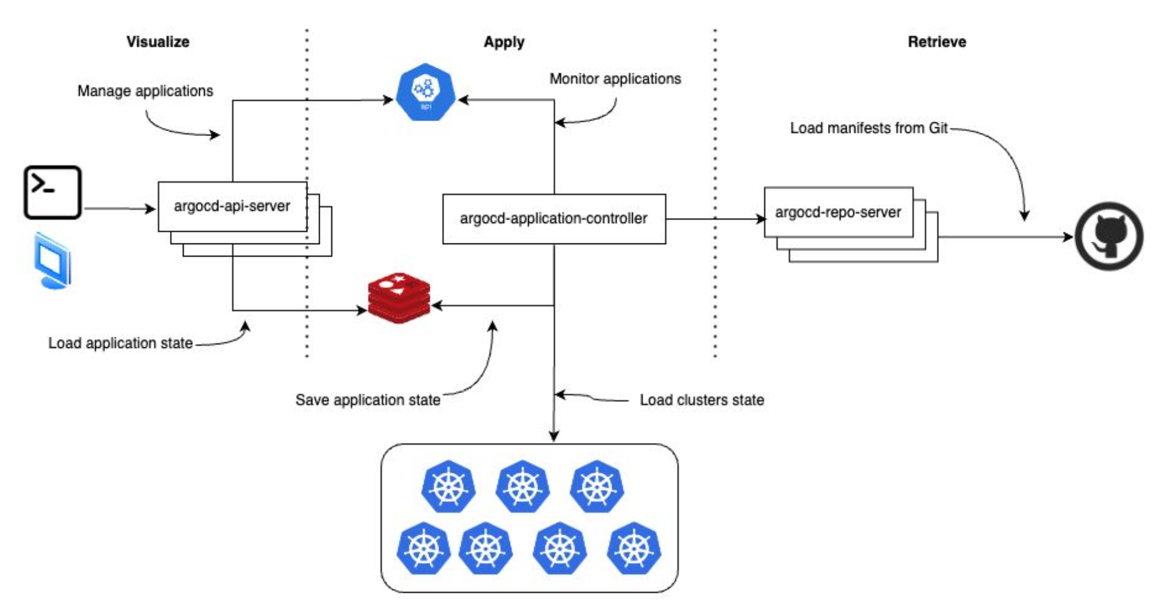
ArgoCD Scaling Challenges
Image: https://colocatedeventseu2023.sched.com/event/1JoAP/scaling-argo-security-and-multi-tenancy-in-aws-eks-at-the-new-york-times-david-grizzanti-luke-philips-the-new-york-times

Slide 32
Scaling ArgoCD
Enable HPA (API, Repo, Redis)
Right size resource requests (cpu, mem)
Controller Replica shards (random, round-robin)
Tunning (timeouts, processors queues)
Data across AZs (Compress)
Reconcile Optimization
ignoreResourceUpdates vs. ignoreDifferences
ArgoCD Webhook with retry/notify (disable polling)
https://argo-cd.readthedocs.io/en/stable/operator-manual/high_availability
https://argo-cd.readthedocs.io/en/stable/operator-manual/reconcile

Slide 33
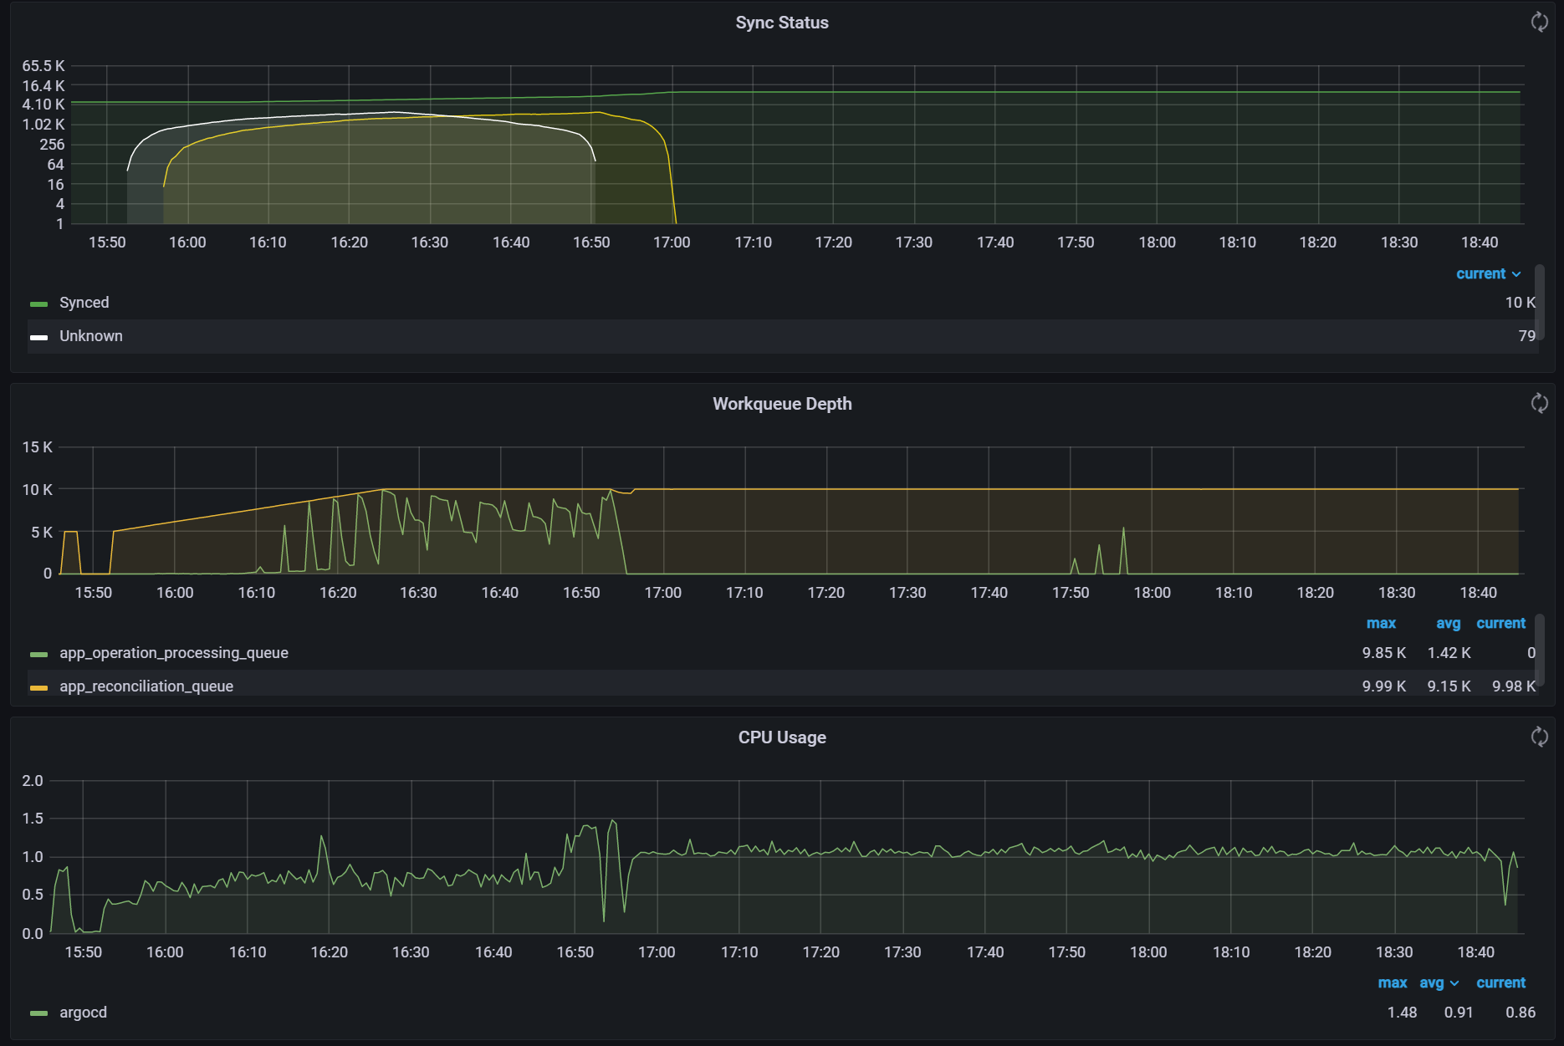
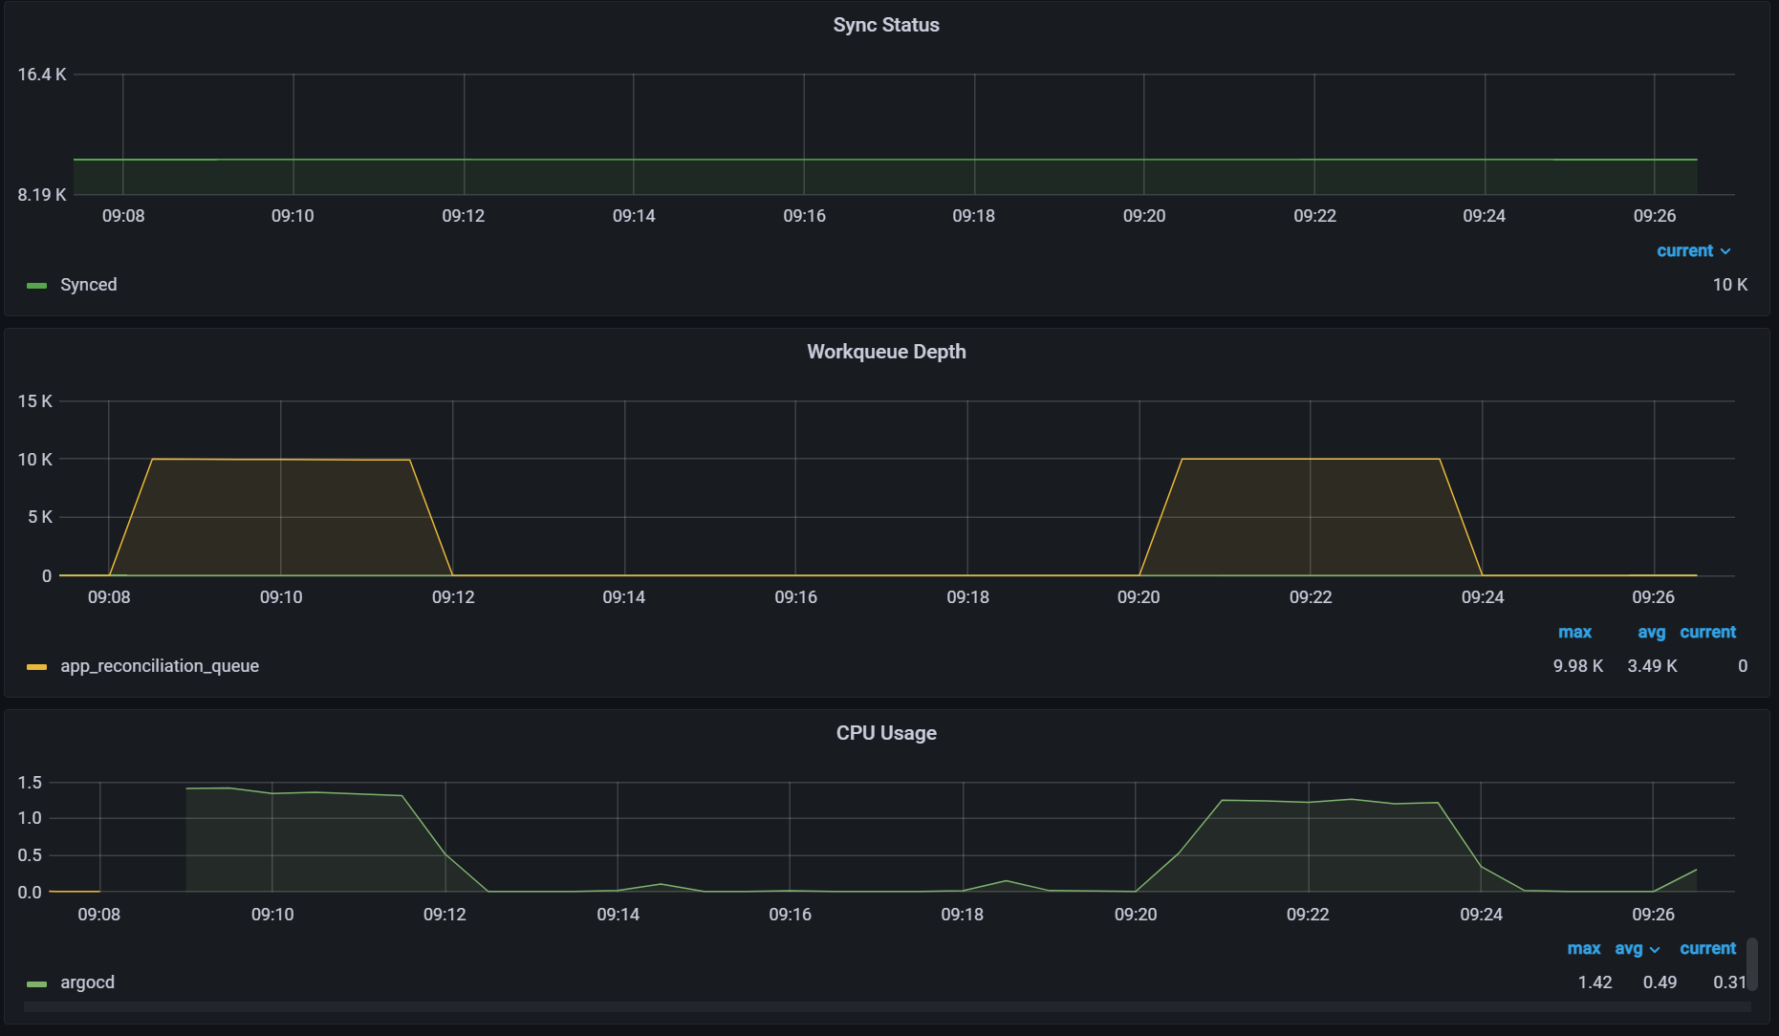
Monitoring ArgoCD
Prometheus
Use Operator or Setup service labels
OpenTelemetry/ADOT
Alerts
AMP (Amazon Managed Service for Prometheus)
Grafana
ArgoCD Dashboard (tweak)
Sync time
Work queue
AMG (Amazon Managed Grafana)
Logging
Find resources to ignore

Slide 34
GitOps Bridge

Slide 35




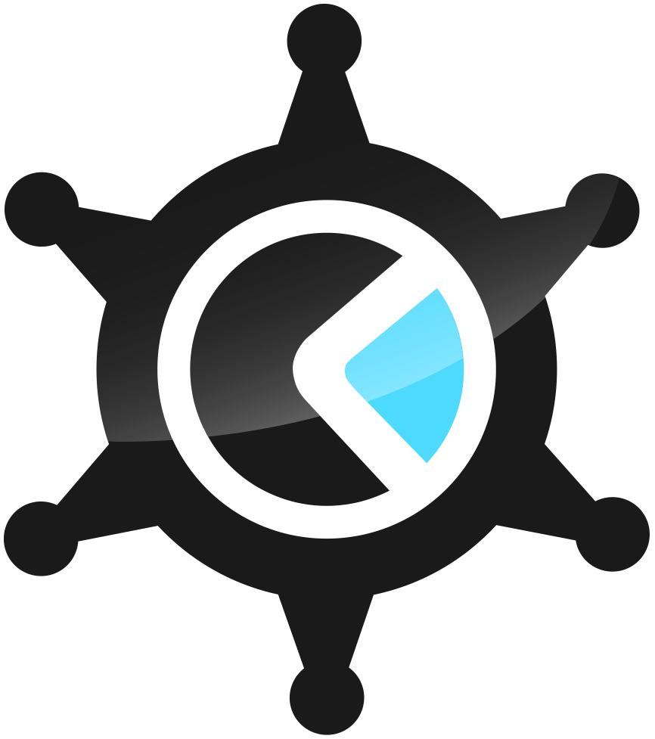


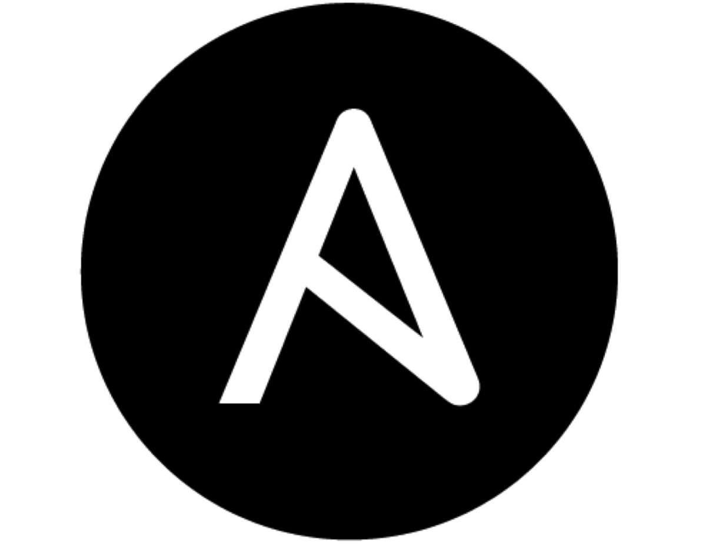





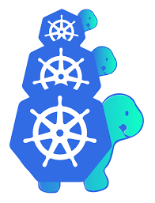

GitOps Bridge: IaC and Addons
https://github.com/gitops-bridge-dev
IaC
Infrastructure
GitOps
1
Virtual private cloud (VPC)
3
./aws/aws-cloudwatch-metrics-appset.yaml
./aws/aws-csi-ebs-resources-appset.yaml
./aws/aws-csi-efs-driver-appset.yaml
./aws/aws-csi-fsx-driver-appset.yaml
./aws/aws-fluentbit-appset.yaml
./aws/aws-gateway-api-controller-appset.yaml
./aws/aws-load-balancer-controller-appset.yaml
./aws/aws-node-termination-handler-appset.yaml
./aws/aws-oss-cert-manager-appset.yaml
./aws/aws-oss-cluster-autoscaler-appset.yaml
./aws/aws-oss-crossplane-providers-appset.yaml
./aws/aws-oss-external-dns-appset.yaml
./aws/aws-oss-external-secrets-appset.yaml
./aws/aws-oss-karpenter-appset.yaml
./aws/aws-oss-privateca-issuer-appset.yaml
./aws/aws-oss-velero-appset.yaml
./aws/aws-secrets-store-csi-appset.yaml
./oss/argo-cd-appset.yaml
./oss/argo-events-appset.yaml
./oss/argo-rollouts-appset.yaml
./oss/argo-workflows-appset.yaml
Subnet
ack
terraform
kops
Kubernetes
Amazon EKS
ansible
pulumi
cdk
IAM Role
NAT gateway
Instances
2
capa
crossplane
Kubernetes CR (ArgoCD Cluster)
metadata:
annotations:
aws_alb_role_arn: arn….
labels:
enable_aws_alb: true

Slide 36
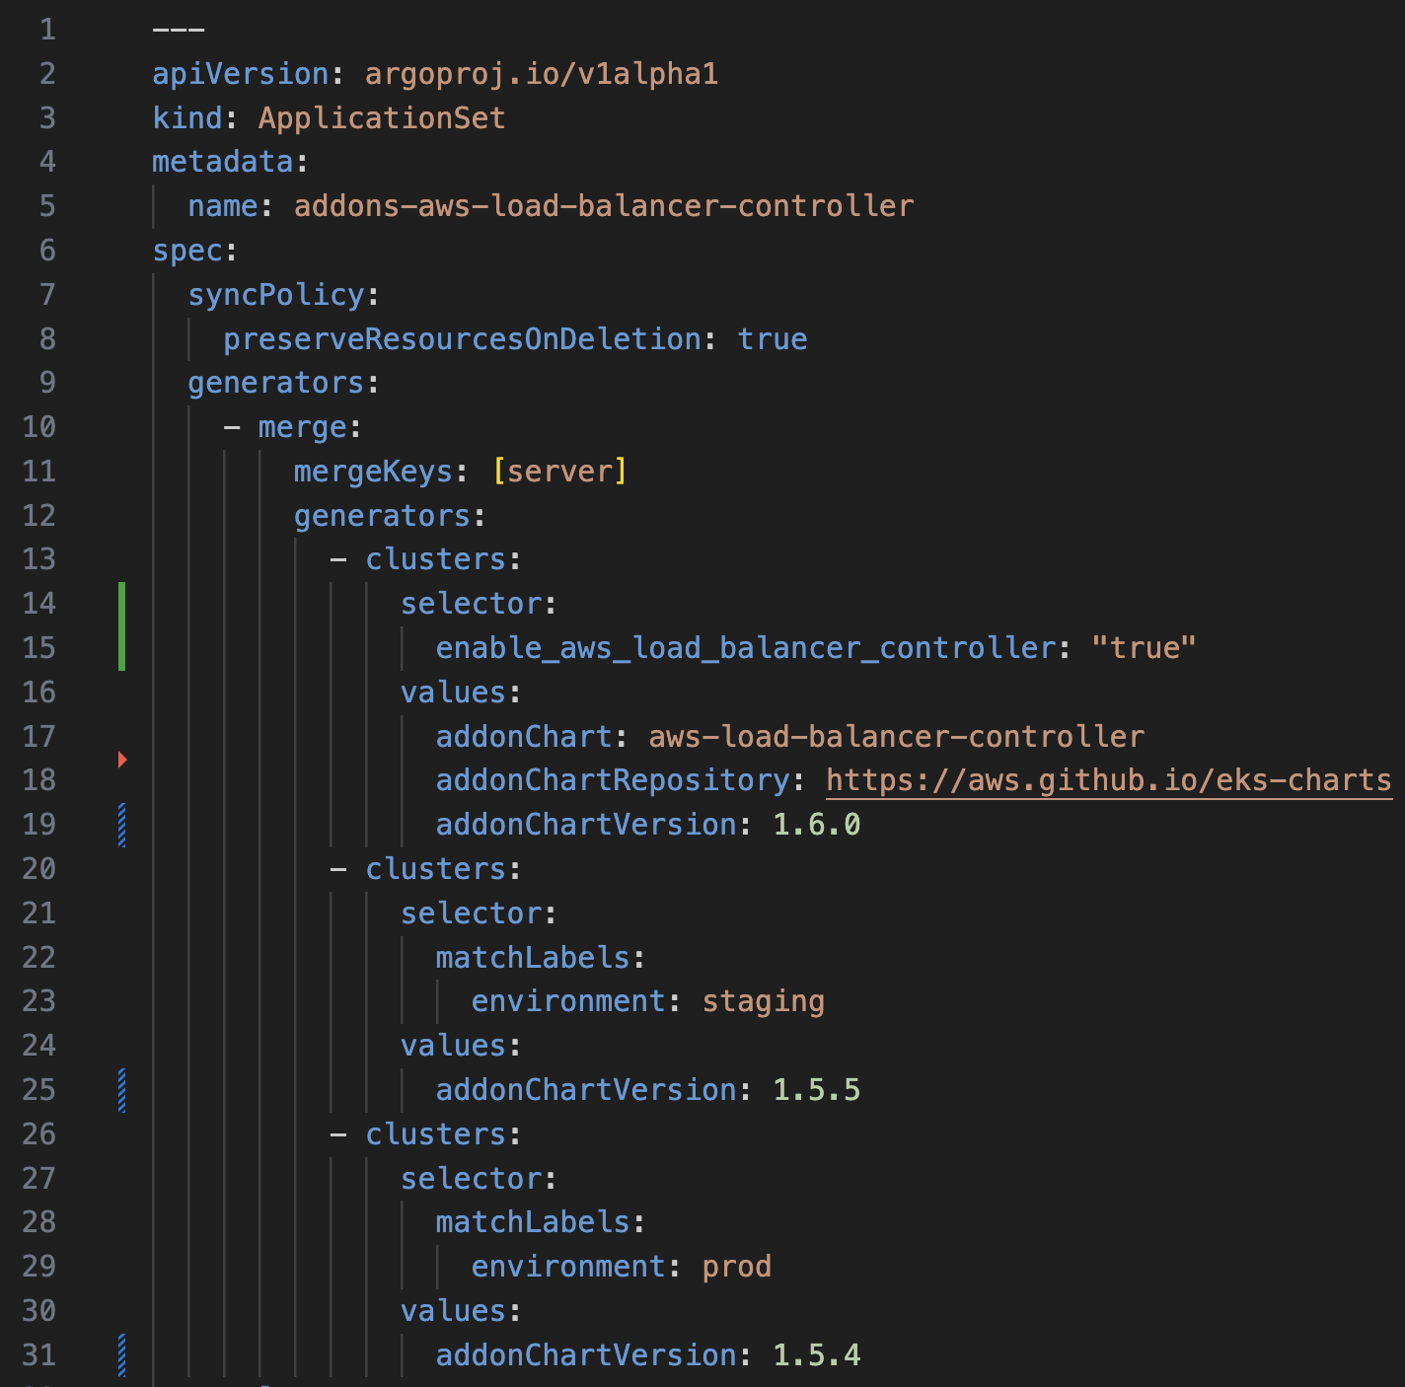
GitOps Bridge: ApplicationSet (Addon versions)
Prevent Outages
Merge generator
Cluster opt-in for the addon
Chart name and repo in a single place
version in dev is 1.6.0
version in staging is 1.5.5
version in production is 1.5.4

Slide 37
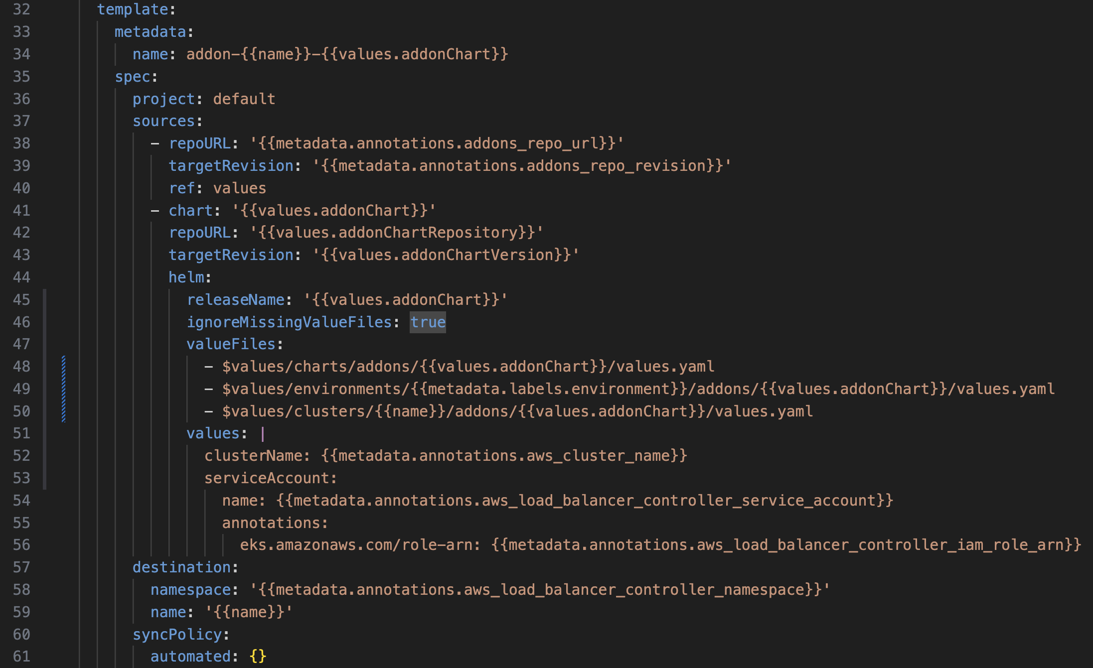
GitOps Bridge: ApplicationSet (overrides)
Value files in git
Override values files
Metadata based on IaC
Namespace based on IaC

Slide 38


GitOps Bridge Configuration
Platform Repo
Account
Region
Control Plane
Kubernetes
Addons
App Of ApplicationSets
App Of AppSet
Addon-1
Kubernetes CR (ArgoCD Cluste)
metadata:
annotations:
aws_alb_role_arn: arn….
labels:
enable_aws_alb: true
Platform team
Addon-2
charts/
environments/
Addon-1
ApplicationSet
Addon-2
ApplicationSet
Addon-3
ApplicationSet
clusters/
Addon-1
Application
Addon-2
Application
Addon-3
Application

Slide 39
Automated cluster deployment

Slide 40


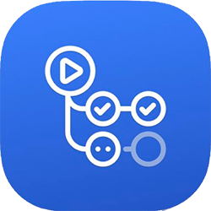
Automated deployment (k8s)
Corporate Network
Corporate datacenter
Teams
Repository
Production Cluster
Dev Team A
Pull
Push
Dev Team B
Git push
Trigger
Dev/Test Cluster
IaC repository
IaC Pipeline
Scanning
Audit Team
Build
Platform Team

Slide 41
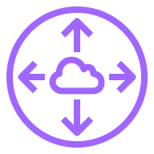
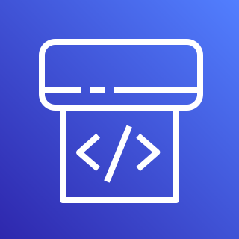
Automated deployment (Cloud)
AWS Cloud
Production account
Teams
Availability Zone 2
Availability Zone 2
VPC
Amazon EKS
Dev Team A
Development tools
Scan
Pull
Push
Dev Team B
Secured Network
Dev/Test account
Git push
Trigger
Availability Zone 2
Availability Zone 2
VPC
IaC repository
IaC Pipeline
Audit Team
Build
VPC
Platform Team

Slide 42


Amazon EKS Blueprints
An open-source framework that allows you to configure and deploy complete Amazon EKS clusters across accounts and Regions
Infrastructure as Code with Terraform and CDK
Based on AWS best practices and recommendations
Integrated with popular K8s tools and services
Fully extensible and customizable

Slide 43
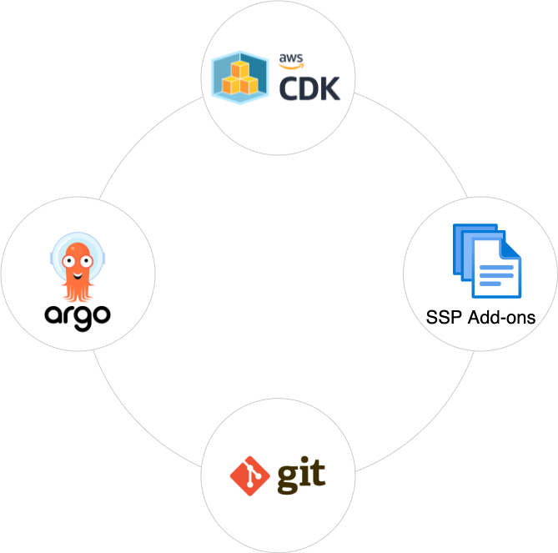
Cluster creation with Amazon EKS Blueprints
Infrastructure as Code (IaC)
AWS CDK
HashiCorp Terraform
Addons
OSS
AWS
Partner
GitOps
ArgoCD - (New GitOps-Bridge)
EKS Blueprints

Slide 44



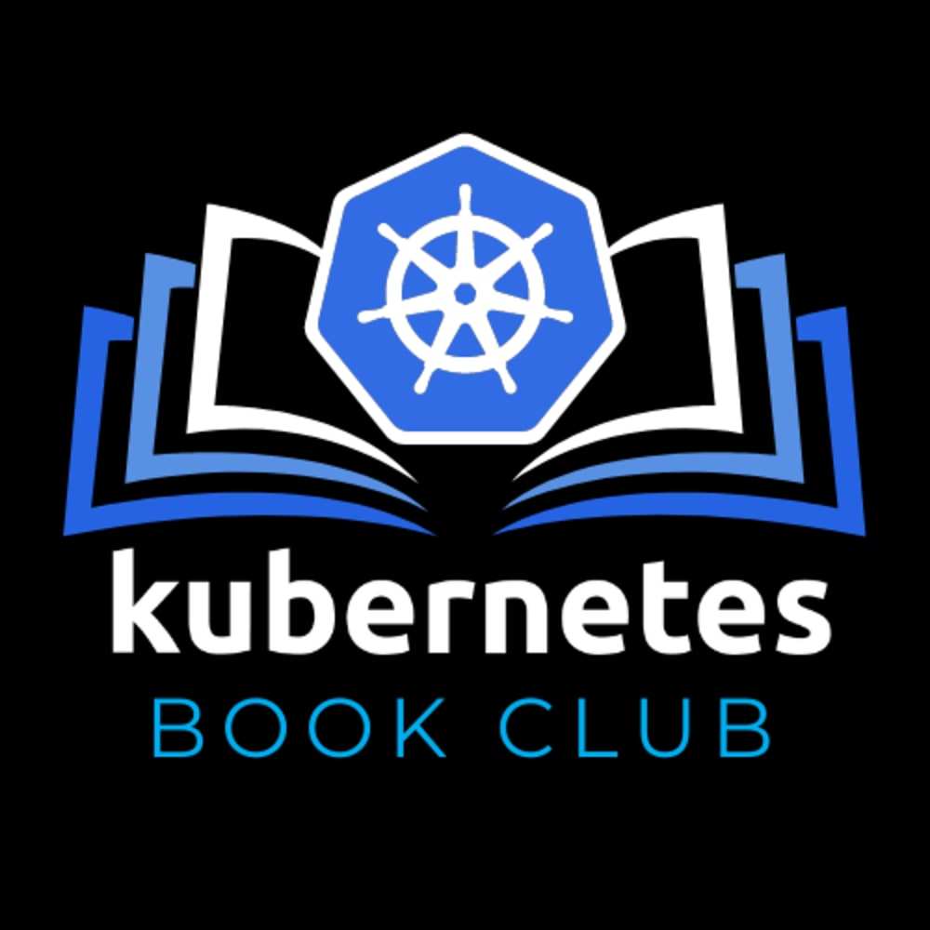
Carlos Santana
Rodrigo Bersa
carrlos@amazon.com
bersr@amazon.com
csantanapr
bersa
@csantanapr

